Slide 1



2: Kalpna Mishra
Object-Oriented Programming Methodology Case Study
Banking System
Project Expo
Team: HelloWorld
Team Members:
Mentor 3: Prof Bhawna D.
Mentor 2: Prof Kalpana M.
Mentor 1: Dr A. Pathre
Vishwasjeet Kr Gupta (Leader- 0131CS221225)
Sunil Rathore (0131CS221208)
Ram Vinay Kumar (0131CS233D14)
Vivek Agarwal (0131CS221226)
Department of Computer Science and Engineering

Slide 2


Object-Oriented Programming Methodology Case Study- Banking System
Contents:
Analysis
Modeling
Input-Output Flow
Program Structure
Git Hub

Slide 3


Object-Oriented Programming Methodology Case Study - Banking System
Analysis
Objective
Studies
Input-Output Analysis
In the first phase, we presented our proposal for this case study. We found our objectives to create a class for customers and banks and perform the different transactions to check balance, deposit cash, withdraw cash, and transfer money. We proposed to create an easy to use and unique system.
We studied the best banking system applications available in the market. We observed all the pros and cons of those software and through our case study, we are proposing our system with some unique features which are not there in these existing applications.
We analyzed all the input and output requirements of a banking system. As banking service requires users’ confidential data, we need to keep it safe and secure. The user’s credentials should be verified before any transaction because unauthorized transactions may lead to fraud.

Slide 4
Object-Oriented Programming Methodology Case Study- Banking System
Modeling
Class Diagram
To visually represent the structure and relationships of classes and conceptual modeling of the application's structure
Use Case Diagram
To illustrate the interactions between system actors and functionalities, outline system behavior and user interactions for system modeling.
Input Output Flow
To outline the data's journey into and out of a system, depicting its processing stages and interactions for system comprehension and analysis.

Slide 5


Object-Oriented Programming Methodology Case Study - Banking System
Class Diagram
Bank
NewUser
- string bank_name - string bank_IFSC - string bank_address
ExistingUser
- string cName - string cAge - string cMob
- string cDob - string cPinCode - string cAddress
- string cID
-string regdUserName
-string regdPswd
+ welcomeMessage()
+void getRegdAccDetails();
+string getRegdUserName();
+string getRegdPswd();
+ getPersonalDetails()
+ generateAccount()
- getMobNoPart()
- getDobPart()
- getAgePart()
- getPinCodePart()
Employee
Authentication
-string AllempId[4] -string AllempPswd[4]
-string empId
-string empPswd
-string check_usrname
-string check_loginPass
-string regdPINCheck
+bool logincheck
+void getEmpDetail()
+void EmpCheck()
+void modiyAccount()
+void modifyAccountMenu()
+void getAuthenticationDetails()
+void doAuthentication()
+void getPinAuthenticationDetails()
+void doPINAuthentication()
Transactions
+ int choice
#float balance
- float amount, transferCharge
+ balanceInquiry()
+ cashDeposit()
+ cashWithdrawl()
+ transferSameBank
+transferOtherBank
+calculateTransCharge
BankDatabase
- int NumOfTransaction
- float monthlyMaintainCharge
+ calculateMonthlyCharge()
friend updateBalance()
friend printAllTransactions()

Slide 6


Object-Oriented Programming Methodology Case Study - Banking System
Use-Case Diagram
Login / Open Account
Balance Inquiry
Authentication
Show Transaction History
Deposit Cash
User
Withdraw Cash
Update Balance
Bank databases
Transfer
Different Bank
Employe
Modify Account
Same
Bank
Calculate Charge

Slide 7

Object Oriented Programming Methodology Case Study - Banking System
Input-Output Flow
Option 1:New User/Account Opening
Main Menu
Welcome to India Bank Limited
Address: Board Office, MP Nagar, Bhopal-462011
IFSC:IBL005710
Hello Sir/Madam...
Please select the option from the following menu to proceed:
Please select the option from the following menu to proceed:
New User
Existing User
Employee
Enter your choice: 1
Thank you for your interest in our bank.
Please fill the form given below to open your account :
1. Name: Rahul Kumar
2. DOB(DD-MM-YYYY): 02-03-2000
3. Mob No.: 9131555689
4. ID card No: 5678 4589 9590
(Aadhar/ Voter Id)
6. Age: 23
7. Address: Sector A, Indrapuri
8. PIN Code: 465647
9. Acc Type(S/C): Saving

Slide 8
Object Oriented Programming Methodology Case Study - Banking System
Input-Output Flow
Account Opening
Your Account is successfully created and your unique account number is generated:
A/c No.: 57020368923647
Please create your user id, login password and transaction PIN to complete the account opening process:
User Name: rk6893m
Login Password: 09876
(min 8 char max 12)
Transaction PIN(6Digits): 689547
Thankyou your account is registered with us with the following details:
Name: Rahul Kumar
A/c No.: 570203689479590
Acc Type: Saving
IFSC: IBL005710
DOB: 02-03-2000
Mob No.: 9131555689
Address: Indrapuri
Pin: 465647

Slide 9

Object Oriented Programming Methodology Case Study - Banking System
Input-Output Flow
Option 2:Existing User/New User After Account Opening
Welcome back…
Thank you for logging in, your registered details are:
Name: Rahul Kumar
A/c No.: 570203689479590
Acc Type: Saving
IFSC: IBL005710
DOB: 02-03-2000
Mob No.: 9131555689
Address: Indrapuri,
Pin: 465647
Please login with your credentials to proceed:
User Name: rk68935m
Password: 09876
Authenticating…
Login Successful
You can proceed now…

Slide 10
Object Oriented Programming Methodology Case Study - Banking System
Input-Output Flow
Service Menu
Choose the services needed:
1. Check Balance
2. Deposit Cash
3. Withdrawal Cash
4. Transfer money to the same bank
5. Transfer money to another Bank
6. Show Account Details
7. Exit
Enter your choice: 1
Enter transaction PIN:
689547
Verified…
Available Balance: 1000

Slide 11
Object Oriented Programming Methodology Case Study - Banking System
Input-Output Flow
Service Menu
Choose the services needed:
1. Check Balance
2. Deposit Cash
3. Withdrawal Cash
4. Transfer money to the same bank
5. Transfer money to another Bank
6. Show Account Details
7. Exit
Enter your choice: 2
Enter PIN: 689547
Verified…
Enter Amount: 50000
Cash Deposit Successful
Available Balance: 51000

Slide 12
Object Oriented Programming Methodology Case Study - Banking System
Input-Output Flow
Service Menu
Choose the services needed:
1. Check Balance
2. Deposit Cash
3. Withdrawal Cash
4. Transfer money to the same bank
5. Transfer money to another Bank
6. Show Account Details
7. Exit
Enter your choice: 3
Enter PIN: 689547
Verified…
Enter Amount: 10000
Cash Withdrawal Successful
Available Balance: 41000

Slide 13
Object Oriented Programming Methodology Case Study - Banking System
Input-Output Flow
Service Menu
Choose the services needed:
1. Check Balance
2. Deposit Cash
3. Withdrawal Cash
4. Transfer money to the same bank
5. Transfer money to another Bank
6. Show Account Details
7. Exit
Enter your choice: 4
Enter PIN: 689547
Verified…
Transfer to A/c No.: 5756383928
Enter Transfer Amount: 5000
Money Transfer Successful
Available Balance: 36000

Slide 14
Object Oriented Programming Methodology Case Study - Banking System
Input-Output Flow
Service Menu
Choose the services needed:
1. Check Balance
2. Deposit Cash
3. Withdrawal Cash
4. Transfer money to the same bank
5. Transfer money to another Bank
6. Show Account Details
7. Exit
Enter your choice: 5
Enter PIN: 689547
Verified…
Transfer to A/c No.: 38420573859
Enter Transfer Amount: 10000
Transfer charges applied…
Money Transfer Successful
Charge Deducted: ₹5
Available Balance: 25995

Slide 15
Object Oriented Programming Methodology Case Study - Banking System
Input-Output Flow
Service Menu
Choose the services needed:
1. Check Balance
2. Deposit Cash
3. Withdrawal Cash
4. Transfer money to the same bank
5. Transfer money to another Bank
6. Show Account Details
7. Exit
Enter your choice: 6
Enter PIN: 689547
Verified…
Name: Rahul Kumar
A/c No.: 57020368923647
Acc Type: Saving
IFSC: IBL005710
DOB: 02-03-2000
Mob No.: 9131555689
Address: Indrapuri,
Pin: 465647

Slide 16
Object Oriented Programming Methodology Case Study - Banking System
Input-Output Flow
Option 3:Employee
Main Menu
India Bank Limited
Hello Sir/Madam
Please select the option from the following menu to proceed:
New User
Existing User
Employee
Enter your choice: 3
Enter Your Employee ID: vishwas7782
Enter Your Password:
843125
Authentication Successful…
Employee Menu
Modify Name :
Modify Age :
Modify DOB :
Modify Mob No. :
Modify Pin Code :
Modify Address :
EXIT :
Enter your choice: 1
Enter the old name to verify:
Rahul Kumar
A/c No:57020368923647
Verified…
Enter Modified Name:
Rahul Gupta
Name Change Successful
Press enter to go back…

Slide 17
Object Oriented Programming Methodology Case Study - Banking System
Input-Output Flow
Option 3:Employee
Employee Menu
Modify Name :
Modify Age :
Modify DOB :
Modify Mob No. :
Modify Pin Code :
Modify Address :
Exit
Enter your choice: 2
Enter the old Age to verify:
23
A/c No:570203689479590
Verified…
Enter Modified Age:
25
Age Change Successful
Press enter to go back…
Enter Your Employee ID: vishwas7782
Enter Your Password:
843125
Authentication Successful…

Slide 18
Object Oriented Programming Methodology Case Study - Banking System
Input-Output Flow
Option 3:Employee
Employee Menu
Incorrect Credential Case
Enter the old DOB to verify:
02-03-2003
A/c No:570203689479590
Incorrect Details…Try Again…
Enter the old DOB to verify:
02-03-2000
A/c No:570203689479590
Verified…
Enter Modified DOB:
02-03-1999
DOB change successful
Press enter to go back…
Modify Name :
Modify Age :
Modify DOB :
Modify Mob No. :
Modify Pin Code :
Modify Address :
Exit :
Enter your choice: 3
Enter Your Employee ID: vishwas7782
Enter Your Password:
843125
Authentication Successful…

Slide 19
Object Oriented Programming Methodology Case Study - Banking System
Input-Output Flow
Transaction History
Your Transaction Details:
Date Transaction Type Amount Charge Balance
1. 05/12/2023 Deposit 50000 0 50000
2. 05/12/2023 Withdrawal 10000 0 40000
3. 05/12/2023 Transfer 5000 0 35000
4. 05/12/2023 Transfer(other bank) 10000 5 24995
Account Summary:
Name: Rahul Gupta
Age:25
DOB:
A/c No.: 570203689479590
IFSC: IBL005710
Maintenance Charge: 0
Total Balance: 24995

Slide 20
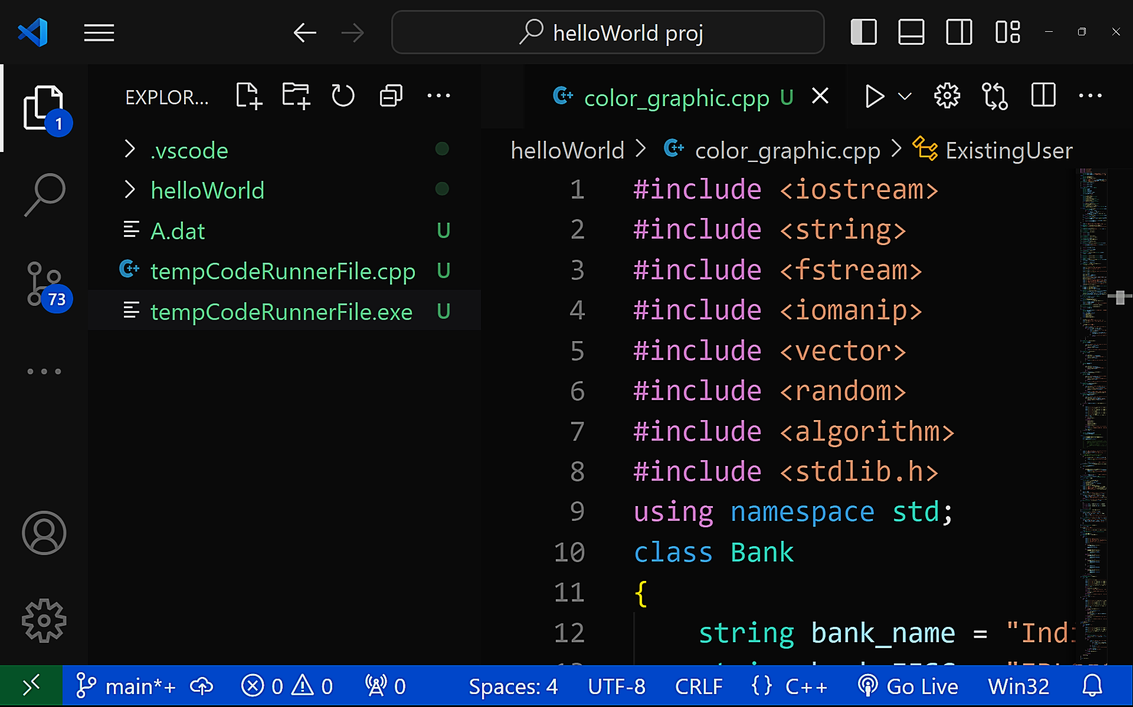
Object-Oriented Programming Methodology Case Study - Banking System
Program Structure
Header Files

Slide 21
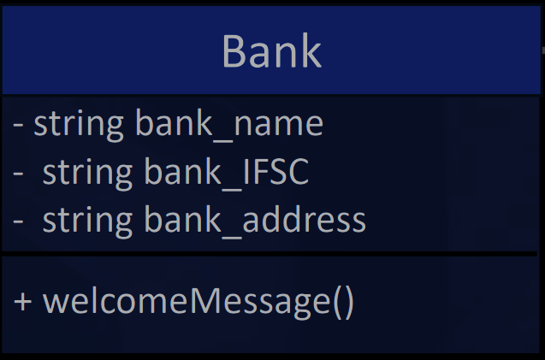
Object Oriented Programming Methodology Case Study - Banking System
Program Structure
Bank class
The Bank class stores the details of the bank like the bank’s name, IFSC code, and Address. It has three data members and one member functions. Data members are kept private to ensure security and unauthorized access.
Data member bank_name stores the name of the bank, bank_IFSC stores the IFSC Code, and bank_address stores the address of the bank.
Member function welcomeMessage() displays the welcome screen and front page of the user interface.

Slide 22
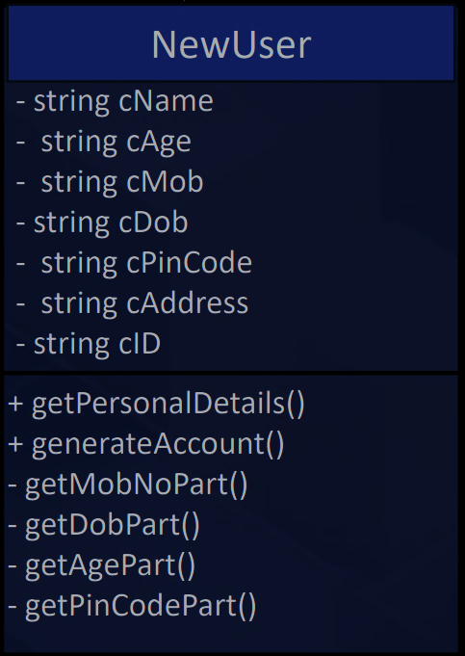
Object Oriented Programming Methodology Case Study - Banking System
Program Structure
NewUser class
The NewUser class takes the user details as input and stores it through private data members. It has seven data members and six member function.
- string cName : User’s name - string cAge : User’s Age - string cMob : User’s mobile number
- string cDob : User’s Date of birth - string cPinCode : User’s PIN code - string cAddress : User’s Address
- string cID : User’s Identity card number
Member function
+getPersonalDetails() - Takes input from the users and stores it in private data members that are already declared.
All other functions are declared to generate unique account number

Slide 23
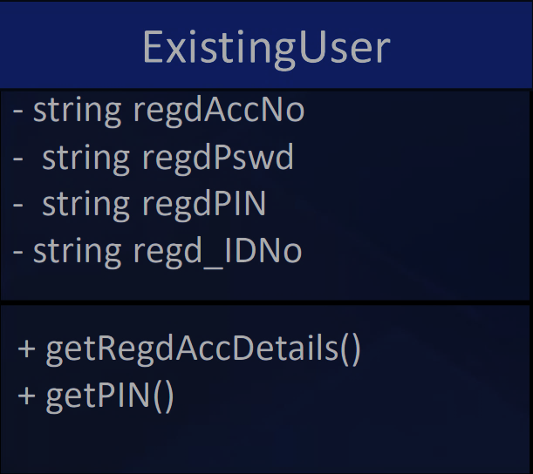
Object Oriented Programming Methodology Case Study - Banking System
Program Structure
ExistingUser
The ExistingUser class will act for the registered user. It is inherited from the bank class and it has four data members and two member functions member function.
- string regdAccNo : Registered User Account Number - string regdPswd : Registered User Login Password - string regdPIN : Registered User PIN
- string regd_IDNo : Registered User Identity Card Number
Member function +getRegdAccDetails() Takes input from the registered users and stores it in private data members. These data will be used in the authentication process in the child class.
+getPIN() function will take the transaction PIN from the user.

Slide 24
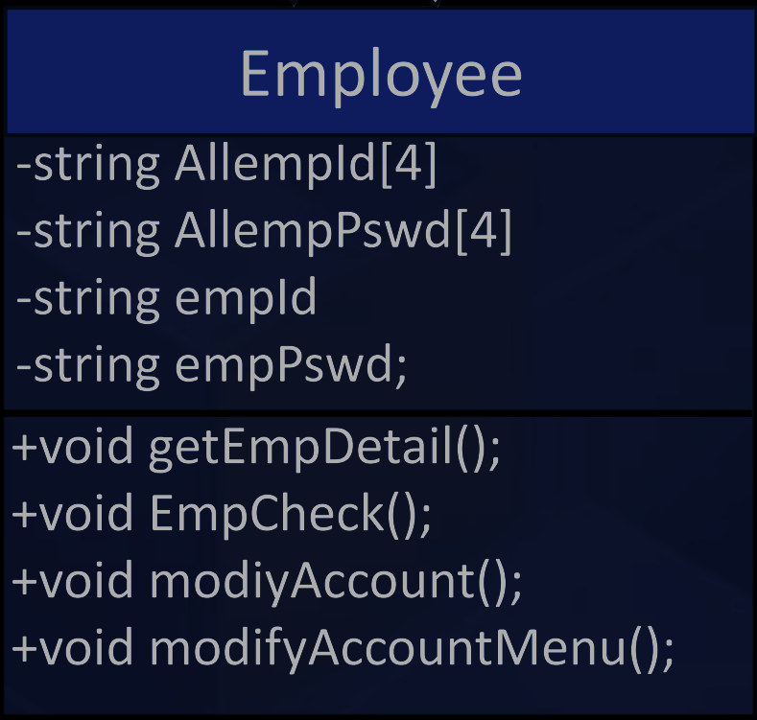
Object Oriented Programming Methodology Case Study - Banking System
Program Structure
Employee
The Employee class will act for bank employees. It is inherited from the NewUser and ExistingUser. This class will be used to modify bank account. It has four data members and four member functions.
- string Allempid[4] : All employee user Ids
- string AllempPswd[4] : Employe’s passwords
- string empid: Input from employee
string empPswd: Input from employee
Member Functions
+ getEmpDetail(): To generate an account number for the new user.
+ EmpCheck() :To get employe detail
+ modifyAccount(): To modify account
+ modifyAccountmenu(): To display menu of modify account

Slide 25
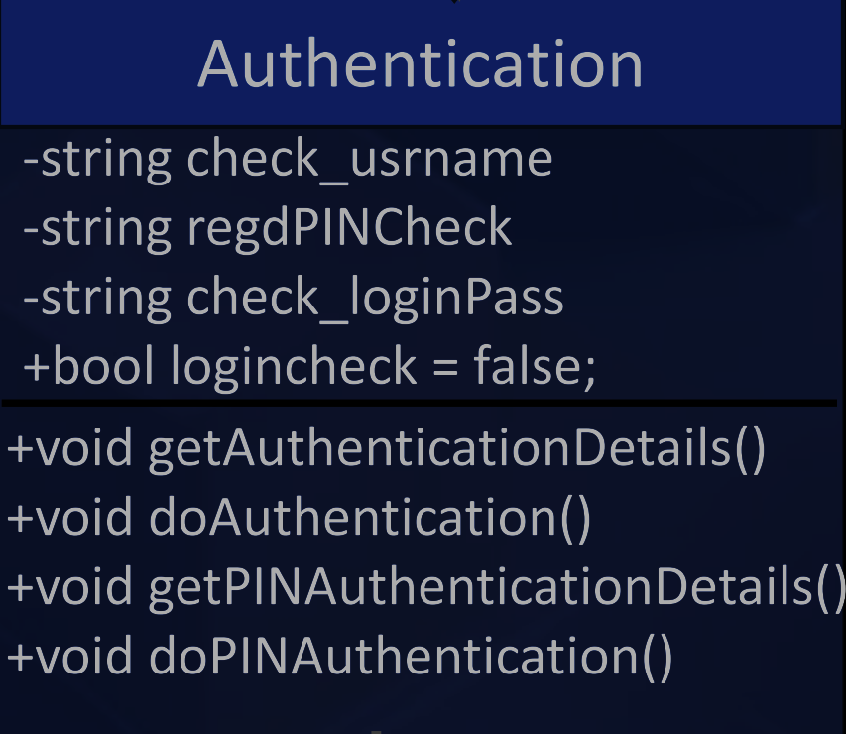
Object Oriented Programming Methodology Case Study - Banking System
Program Structure
Authentication
The Authentication class will act for both types of users. It has one parent class, Employee.
-string check_username : User number for authentication.
- string regdPswdCheck : Password for Authentication.
- int regdPINCheck : Transaction Pin for Authentication.
Member Function :
+getAuthenticationDetails() : Get details from the user for Authentication
+voiddoAuthentication(): To verify
+ getPINAutehnticationDetails(): To get PIN authentication
+voiddoPINAuthentication(): To do PINAuthentication

Slide 26
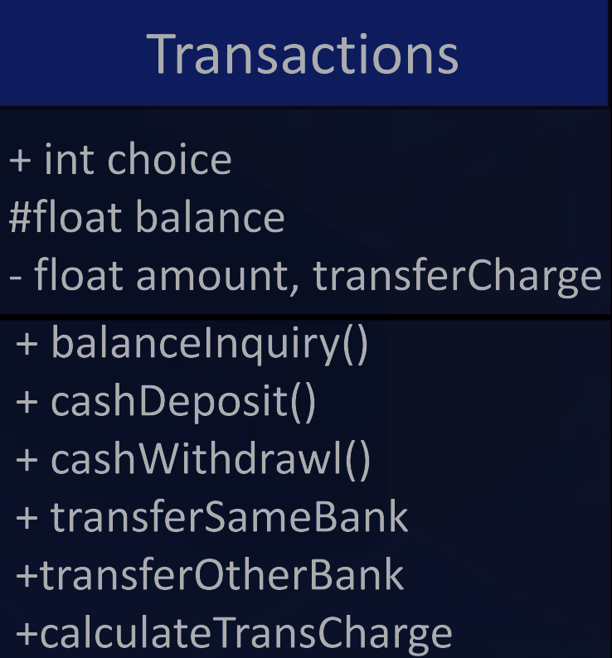
Object Oriented Programming Methodology Case Study - Banking System
Program Structure
Transactions
The Transactions class will act for both types of users. It is inherited from the Authentication class. This class will be used to perform all the transactions for the users. It has Four data members and Six member functions.
+ int choice : selecting the option from the list of services.
# float balance : Account opening balance.
- float amount : Transaction amount for Deposit, Withdrawal, and Transfer.
- transferCharge : Calculated transfer charge.
Member Function :
+ balanceInquiry() : To check account balance.
+ cashDeposit() : To deposit cash.
+ cashWithdrawl() : To withdraw cash.
+ transferSameBank : To transfer money to same bank.
+transferOtherBank : To transfer money to other bank .
+calculateTransCharge : To calculate transfer charges.

Slide 27
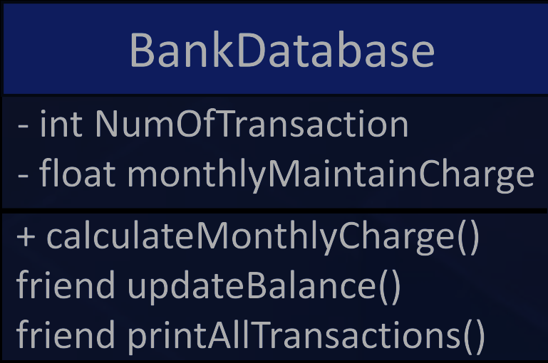
Object Oriented Programming Methodology Case Study - Banking System
Program Structure
BankDatabase
The BankDatabase class holds all the data of the user securely and it has attributes to keep the record of transactions. It has two data member and three member function.
- int NumOfTransaction : Store number of transactions.
- float monthlyMaintainCharge : Monthly maintenance charge for users.
Member function :
+ calculateMonthlyCharge : To calculate monthly charges.
friend updateBalance() :To update user’s account balance.
friend printAllTransactions() : To print all transaction details.

Slide 28
Object Oriented Programming Methodology Case Study - Banking System
Git Hub
Click to go to the link:
HelloWorld-Banking-System

Slide 29






Object Oriented Programming Methodology Case Study - Banking System
Team: HelloWorld
Vishwasjeet Kr Gupta
Sunil Rathore
Ram Vinay
Vivek Agrawal
(0131CS221225) (Team Leader)
(0131CS221208) (Team Member)
(0131CS233D14) (Team Member)
(0131CS221226) (Team Member)

